Slide 1

Steal the Deal Day!
Supermarket Business Analysis
Data Analyst
Varshini S
Date
February 24,2024

Slide 2
Project Overview
Data Description
Business Statement
Supermarket sales
Sales data from Jan. to Mar. 2019 in
Super Saver Day Promotion
Rewarding our loyal members and
3 cities in Myanmar
attracting new ones
Contains key data on branch,
Encouraging more spending
product line, gross income, rating,
Increasing customer satisfaction
and more ..
*Reference: Supermarket sales (kaggle.com)

Slide 3
Key Challenges & Constraints
Methodology
Challenges
Constraints
Trello Kanban
Limited data frame
Leverage SQL queries for in-depth analysis of complex data relationships, like customer behavior
Data import
Entity-Relationship-Di
Define the Primary Key
agram
and Foreign Key
Exploratory Data
Analysis

Slide 4
Design ER
SQL
Use SQL Queries
SELECT AS
JOIN ON
WHERE
GROUP BY
RANK OVER
Create Database
Import Data

Slide 5
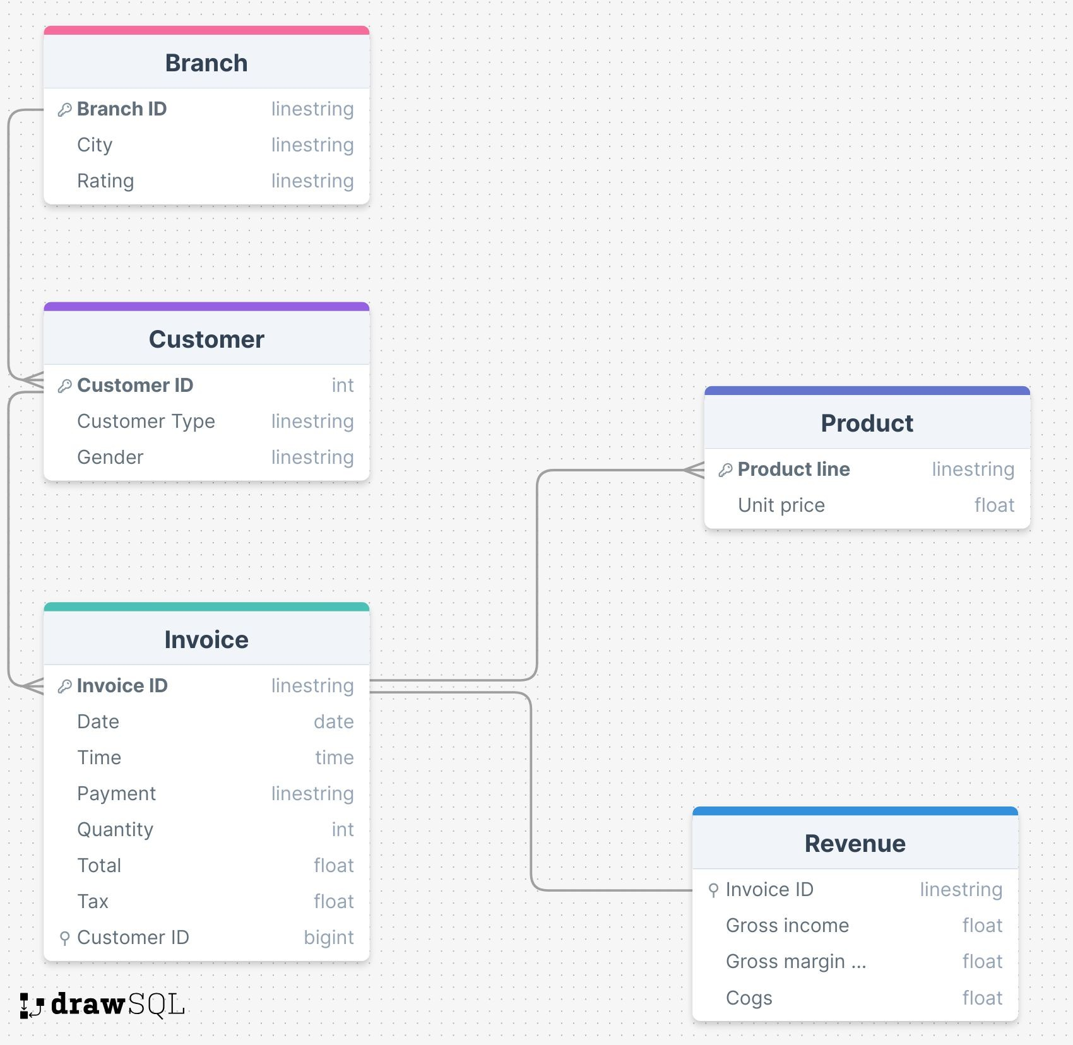
Database Design
Entity-Relational-Model
Entity - Relationship
Branch to Customer: 1 to Many
Customer to Invoice: 1 to Many
Product to Invoice: Many to 1
Invoice to Revenue: 1 to 1
Keys:
Primary Key: Customer ID; Branch ID; Invoice ID; Product line
Foreign Key: Customer ID as FK in Invoice/Invoice ID as FK in Revenue

Slide 6
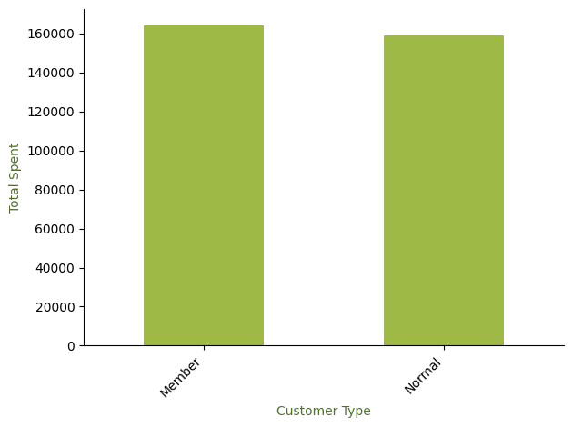
Business Insights
Customer Analysis
Total spent of Member / Normal Customers

Slide 7
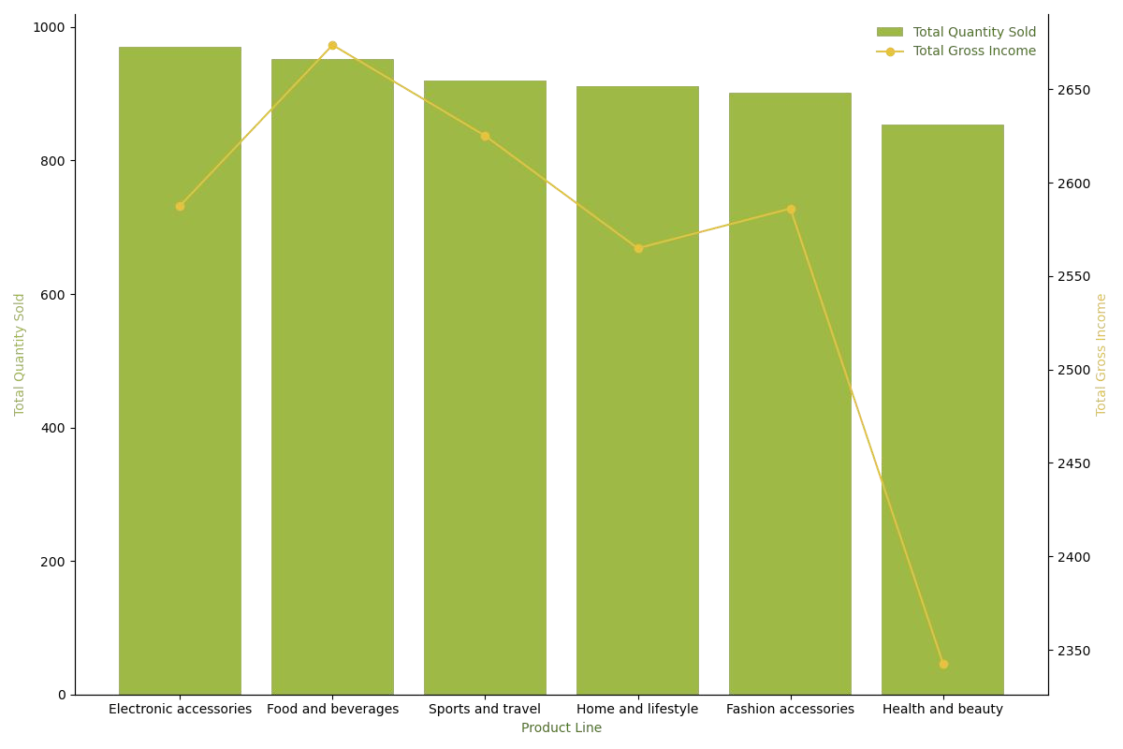
Business Insights
Product Analysis
Total Quantity Sold & Total Gross ($) Income of Product lines

Slide 8
Summarize
There is no difference in the amount of money spent by members and normal customers.
Best-selling product line: Electronic accessories.
Most profitable product line: Food and beverage.
Importance of having a database to keep tracking customer behavior.
Deal Day Promotion
Promote the most profitable product line to leverage sales and profit.
Offer promotions exclusively to members to increase the number of memberships.

Slide 9
Thank you!

